Slide 1


AML Chart Abstraction
Summer Internship 2025
Richard Aplenc, MD PhD & Kelly Getz, MPH PhD

Slide 2
Outline
Introduction to Pediatric Acute Myeloid Leukemia
Introduction to our Cohort
Description of Training/ Summer Procedures
General Expectations / Objectives

Slide 3
Pediatric AML Introduction

Slide 4
Pediatric AML Background
Pediatric AML is the second most common pediatric leukemia
  ~500 children aged 0-14 diagnosed each year in the US
    Overall survival: 66%
Adult AML is more common with worse prognosis
  ~20K new diagnoses each year in the US
  Overall survival: 29%
Pediatric AML exhibits distinctive and critically important characteristics
  What works in adults may not work in peds - and vice versa
Bolouri et al, Nature Medicine, 2018

Slide 5
Pediatric AML Frontline Therapy
Intensive and primarily inpatient
  Most intensive chemotherapy outside of allogeneic donor stem cell transplantation (SCT) that is given to children
Therapy consists of two induction chemotherapy courses
  70% of patients then get two-three consolidation chemotherapy courses
  30% of patients then get one consolidation chemotherapy course then go to SCT
Risk stratification (High vs. Low vs. Intermediate risk at the End of Induction 1) is evolving
  May impact the proportion of patients receiving SCT in first remission.
  Current research investigating relative benefit of SCT in first remission for different subpopulations

Slide 6
Refractory and Relapsed Pediatric AML
~50% of pediatric patients will experience AML relapse
Refractory AML has a uniformly poor prognosis
  Refractory = evidence of disease without achieving remission
Relapsed AML generally has a poor prognosis
  Relapse = evidence of disease after achieving remission
  Shorter time to relapse associated with worse outcomes
Stem cell transplant is required for cure
Treatment options are increasing but limited
Gorman et al, 2010, PBC

Slide 7
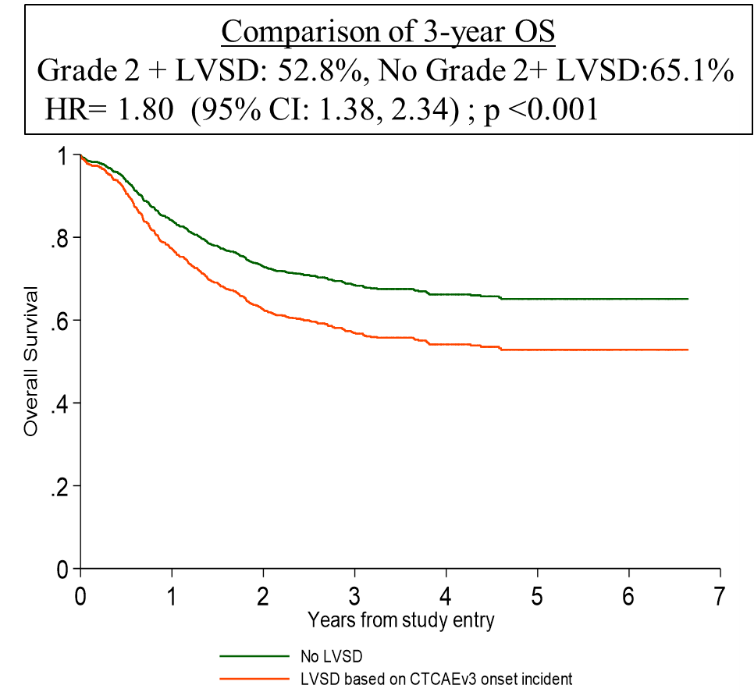

Cardiotoxicity
Common consequence of anthracycline-based therapy
  40% experience declines in cardiac function warranting chemotherapy modifications
  21% suffer declines in cardiac function consistent with moderate to life-threatening cardiomyopathy/heart failure
Early cardiotoxicity is associated with worse overall survival
Trade-offs for adjusting chemotherapy to preserve cardiac function
  Goal to create evidence-based monitoring and treatment schedules to optimize outcomes
Cardiotoxicity may impact treatment in setting of relapse and contribute to outcome disparities
No LVSD
Early LVSD
LVSD: left ventricular systolic dysfunction

Slide 8
Our Cohort

Slide 9
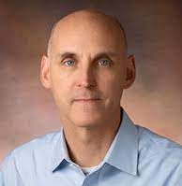
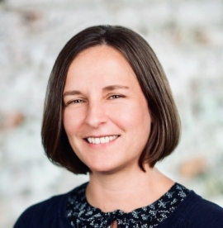
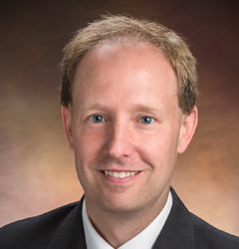
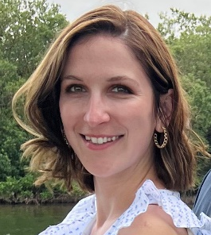
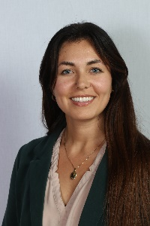
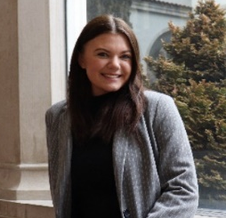
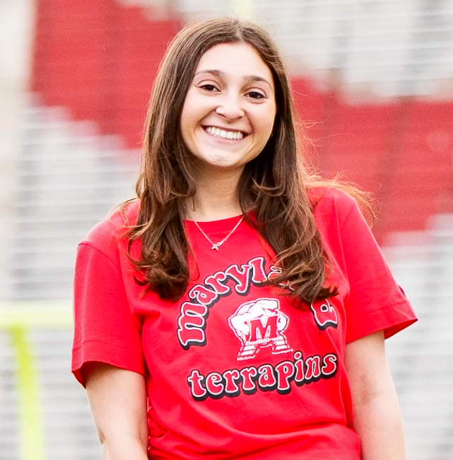
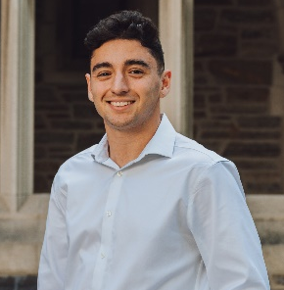
The Team
PIs
&
ALSF Mentors:
Dr. Richard Aplenc
Dr. Kelly Getz
Dr. Brian Fisher
Project
Managers:
Research
Assistants:
Lisa
Alexis
Erin
Alexa
Jose

Slide 10
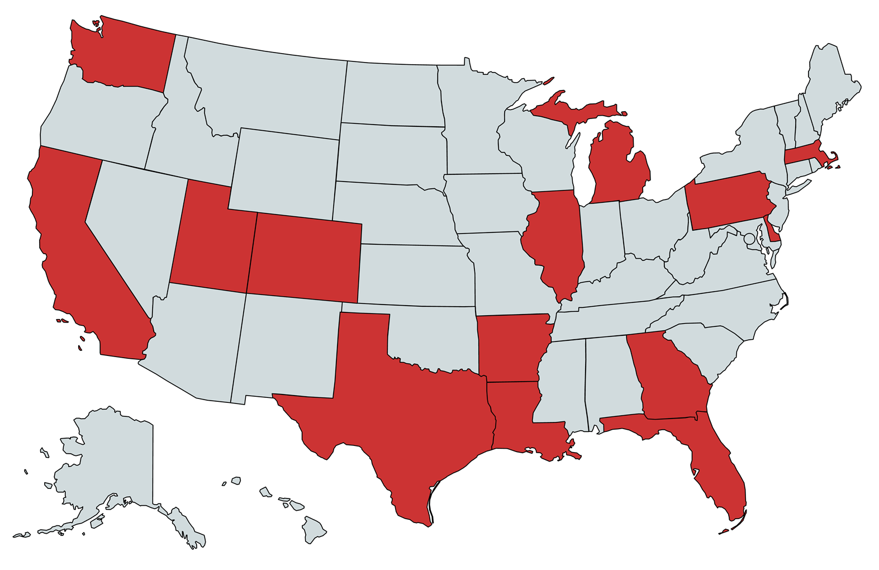
Nationwide Collaborating Sites

Slide 11
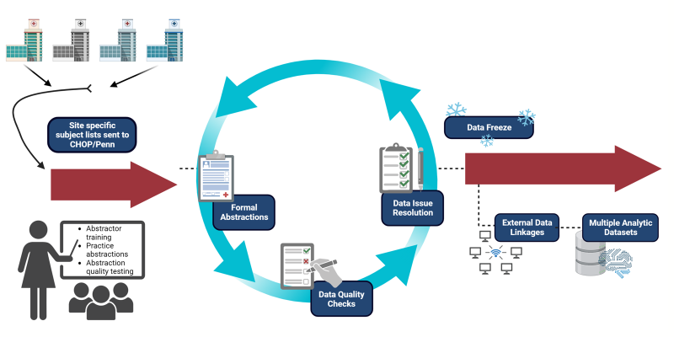
Annual Abstraction Methodology

Slide 12
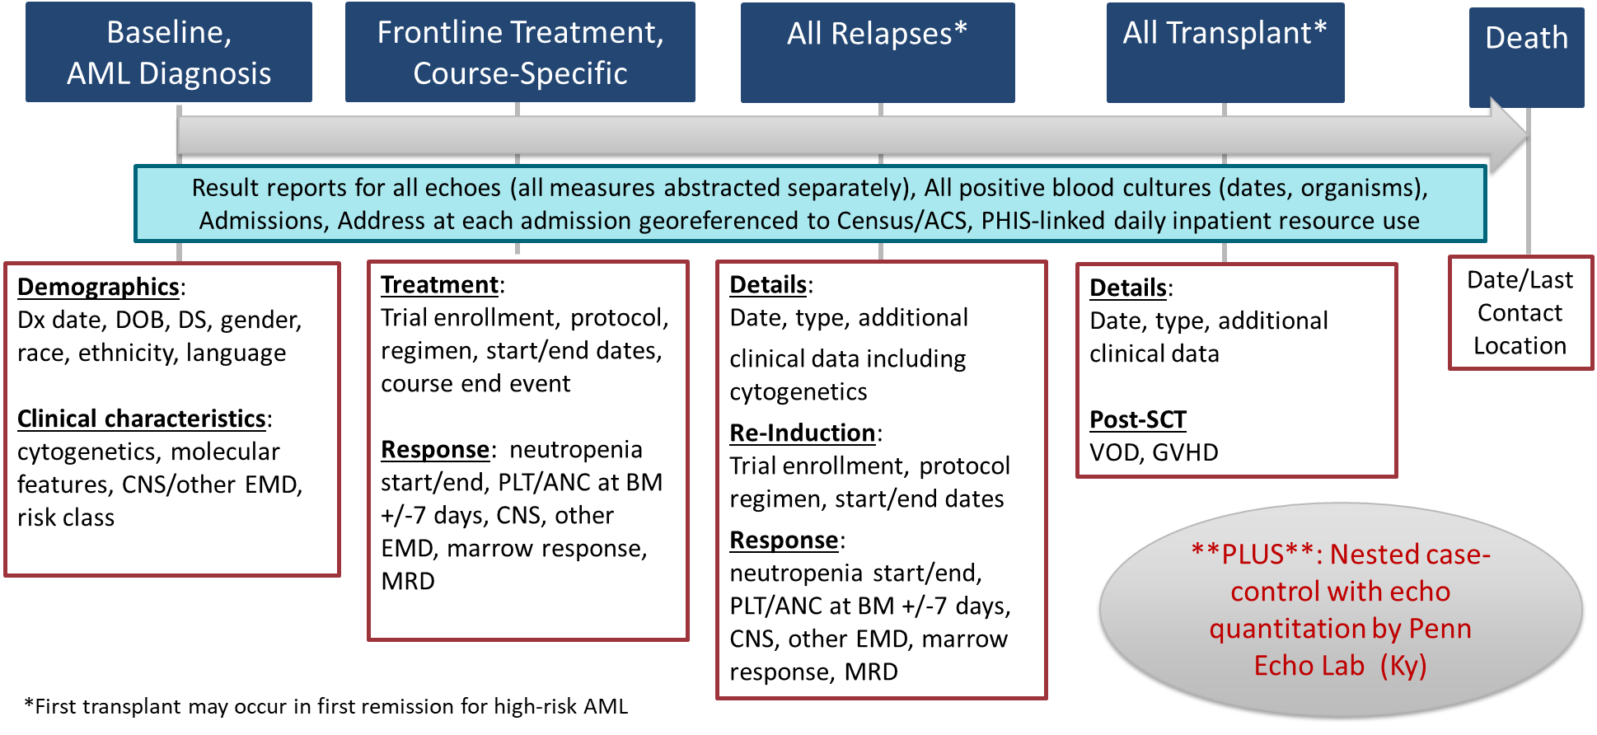
Extensive Data Collection

Slide 13
Scope Of Data Collection Work
Every Summer/Fall we:
  Abstract New Patients diagnosed in past year
  Update all existing (legacy) patients
600 New Patients est. for this cycle | 4.5 hours each | 2700 hours
1000 Legacy Patients | 1 hour each | 1000 hours
Quality checks | 1-4 weeks per site | 20 weeks
135 weeks or 2.6 years for a single person to complete…
As a team, we finish before Thanksgiving.

Slide 14
Grants Utilizing Cohort / Supporting Staff and Data Collection
Our group’s AML Areas of Interest include Clinical Outcomes, Genetic Factors, Cardiotoxicity, Relapse, Transplant, Blood Culture Susceptibility, Infectious Disease, Barriers to Care, Racial/Ethnic/Financial Disparities, Epidemiologic/Biostatistical Methods Development
PCORI CER-1409-22827 Home or Away from Home: Comparing Chemotherapy Recovery at Home versus in the Hospital for Children with Acute Myeloid Leukemia– Dr. Aplenc
R01HL164925 Treatment-Related Cardiotoxicity in Children with Relapsed AML: Natural History, Occurrence, and Implications - Dr. Getz
R01HL163657 Predicting & Monitoring for Cardiac Toxicity in Pediatric AML – Dr. Aplenc & Dr. Getz
Addressing Disparities in Pediatric Leukemia – Dr. Aplenc & Dr. Alix Seif
PCORI ME-2021C3-24942: Statistical Methods for Optimizing Dynamic Patient-Level Treatment and Monitoring Strategies - Dr. Getz & Dr. Jason Roy (Rutgers)

Slide 15
Sample of Projects Using the Cohort
American Society of Hematology 2023 Conference Presentations
Establishing Real-World Data-Driven Response Criteria in Pediatric AML – Dr. Richard Aplenc Blood (2023) 142 (Supplement 1): 726. https://doi.org/10.1182/blood-2023-185647
Comparative Effectiveness of Re-induction Approaches for Relapsed AML – Dr. Caitlin Elgarten Blood (2023) 142 (Supplement 1): 551.https://doi.org/10.1182/blood-2023-188044
Racial & Ethnic Differences in Acuity & Organ Toxicity at Relapse in AML – Dr. Daniel Zheng Blood (2023) 142 (Supplement 1): 387. https://doi.org/10.1182/blood-2023-180713
Survival Disparities By Trial Enrollment Status for Treatment of Pediatric AML – Dr. Daniel Zheng Blood (2023) 142 (Supplement 1): 2430. https://doi.org/10.1182/blood-2023-189240

Slide 16
Training / Summer Schedule

Slide 17
Training Day 6/3/24
  8:15-8:45 am: Morning meeting with Dr. Aplenc, Dr. Getz, Project Managers, CRAs
    Breakfast provided
  9-10 am: Introduction to AML led by Dr. Aplenc or Dr. Getz
  10 AM-4 PM: Abstraction Training session led by Project Manager(s)
    Laptops and Lunch provided

Slide 18
Rigorous Training Standards
After training day- you will be assigned 3 practice patients to abstract
  ≥95% concordance – Certified to abstract!
  <95% concordance – Provided feedback, review with Project Manager(s), assigned 2-3 more practice patients
We allow for a maximum of 3 rounds of practice to reach 95% concordance.
  If requirement not met within 3 rounds, intern will be offboarded from CHOP/Penn and will need to find a different summer experience

Slide 19
Standing Meetings / Learning Opportunities
Weekly Check-In Meetings
  Monday Mornings, 8:15-8:45 AM
    Set goals for week
    Review site assignments
  Friday Afternoons, 4:00-5:00 PM
    Review week’s progress (obstacles, concerns, triumphs)
    Career Development and/or other discussions as per your interests with Drs. Aplenc and Getz
Shadowing Experience
  We will pair you with a clinician for one day of shadowing to experience the clinical side of pediatric oncology

Slide 20
Expectations / Objectives

Slide 21
General Learning Objectives
Develop an understanding of:
  Pediatric acute myeloid leukemia biology, treatment, and clinical outcomes
  Clinical research processes
Become proficient in medical chart abstraction
Engage with Drs. Aplenc and Getz to learn about different career paths and research areas

Slide 22
Our Expectations of All Interns
General
8 weeks of 40 hours of on-site work
Business casual attire
  Dress professionally when shadowing
Come to work prepared with all materials (e.g., laptop, charger, binder, USB cord)
Use prepared guidance materials for every abstraction – first resource for questions
Timely responses to assigned tasks
Keep Alexis and Lisa cc’d on all emails
Big Picture
Self-Motivated
Emphasize Attention-to-Detail
Active engagement in training and abstractions
Ask questions when you don’t know
Engage kindly with the all team members
Say what you mean, mean what you say, and don’t say it mean
Have fun!

Slide 23
Our Expectations of Ourselves
Provide structured and sufficient training / guidelines for you to succeed
Remain available for questions and discussion
Deliver timely and honest feedback
Promote intensive learning so you leave the summer with a rich knowledge base of pediatric AML
Provide learning opportunities outside of abstractions (Clinician Shadow Opportunity, Friday afternoon development meetings)
Create a culture where you are comfortable asking questions

